Slide 1
Graphs
CSI 219 – Discrete Mathematics

Slide 2
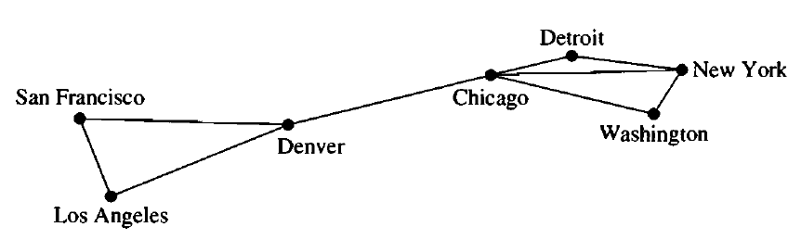
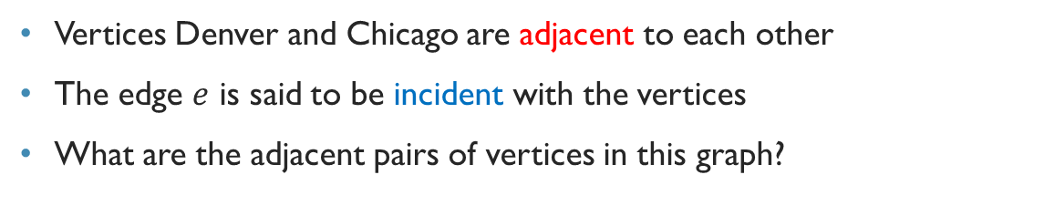

Graph terminology (Undirected graph)
$$e$$
Vertices Denver and Chicago are adjacent to each other
The edge $e$ is said to be incident with the vertices
What are the adjacent pairs of vertices in this graph?

Slide 3
Degree of a vertex (Undirected Graph)
The degree of a vertex in an undirected graph is the number of edges incident with it, except that a loop at a vertex contributes twice to the degree of that vertex.

Slide 4
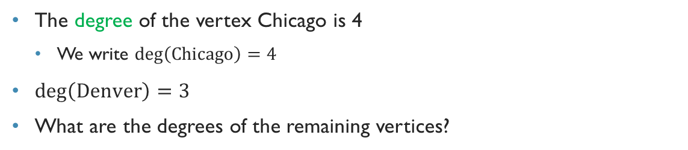
Graph terminology (Undirected graph)
The degree of the vertex Chicago is 4
We write $\deg\left(\text{Chicago}\right)=4$
$\deg\left(\text{Denver}\right)=3$
What are the degrees of the remaining vertices?

Slide 5
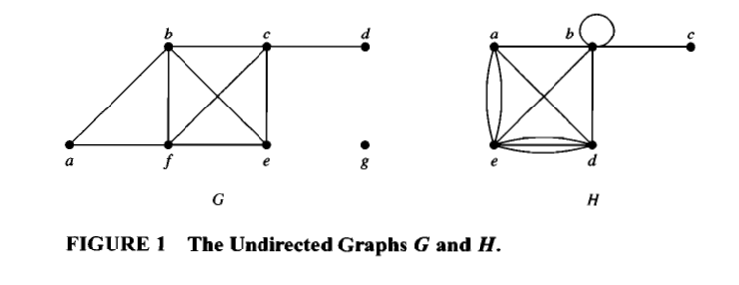
Example
What are the degrees of the vertices in the graphs G and H displayed in Figure I?

Slide 6
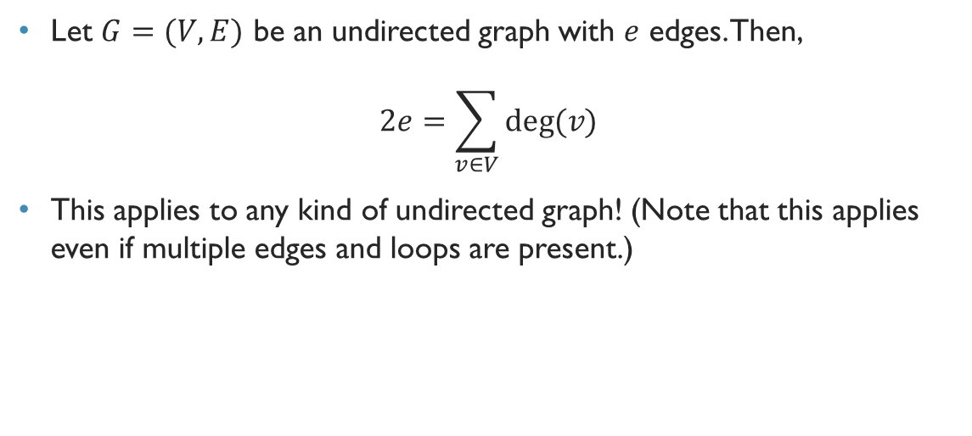
Handshaking theorem
Let $G=(V,E)$ be an undirected graph with $e$ edges. Then,
$$2e=\sum_{v∈V}{deg⁡(v)}$$
This applies to any kind of undirected graph! (Note that this applies even if multiple edges and loops are present.)

Slide 7
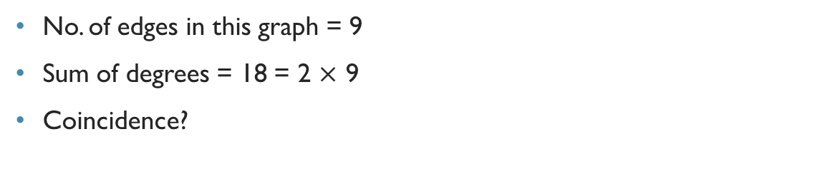
Handshaking theorem
No. of edges in this graph = 9
Sum of degrees = 18 = 2 $×$ 9
Coincidence?

Slide 8
Quick exercise
How many edges are there in a graph with 10 vertices each of degree six?

Slide 9
Another theorem
An undirected graph has an even number of vertices of odd degree.
Really??

Slide 11
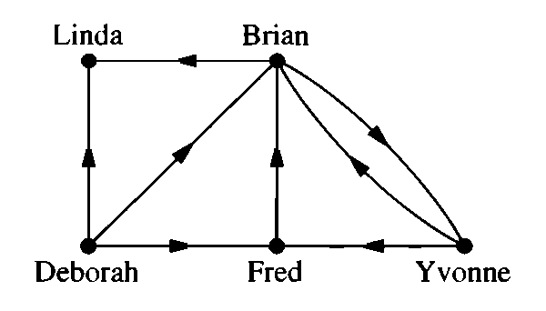
Graph terminology (directed graph)
Vertices Deborah is adjacent to Brian, and Brian is adjacent from Deborah
Deborah is the initial vertex of the edge, and Brian is the terminal vertex of the edge

Slide 12
Degree of a vertex (Directed Graph)
In a graph with directed edges the in-degree of a vertex v, denoted by degˉ(v), is the number of edges with v as their terminal vertex.
The out-degree of v, denoted by deg +(v), is the number of edges with v as their initial vertex.
Note that a loop at a vertex contributes 1 to both the in-degree and the out-degree of this vertex.

Slide 13
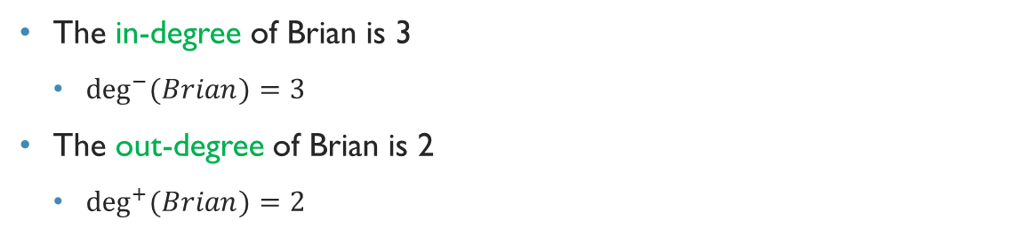
Graph terminology (directed graph)
The in-degree of Brian is 3
$\deg^{−}{(Brian)}=3$
The out-degree of Brian is 2
$\deg^{+}{(Brian)}=2$

Slide 14

Handshaking theorem (directed graph)
The sum of in-degrees is 8
The sum of out-degrees is 8
No. of edges is 8
Coincidence?

Slide 15

Handshaking theorem (directed graph)
Let $G=(V,E)$ be a graph with directed edges. Then
$$\sum_{v∈V}{\deg^{−}{(v)}}=\sum_{v∈V}{\deg^{+}{(v)}}=\left|E\right|$$

Slide 16
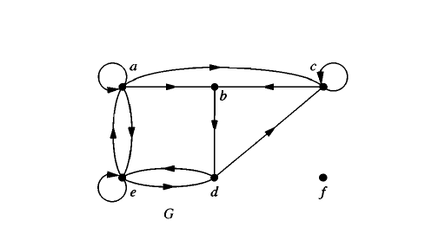
Example

Slide 17
Some special simple graphs

Slide 18
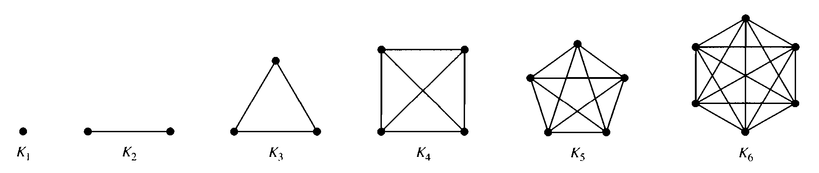
Complete graph
Simple graph where there is exactly one edge between each pair of distinct vertices.

Slide 19
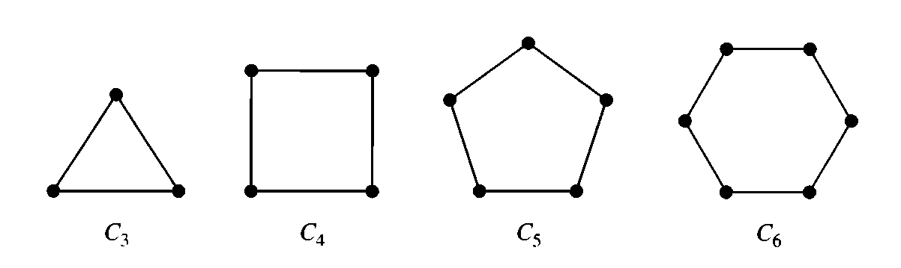
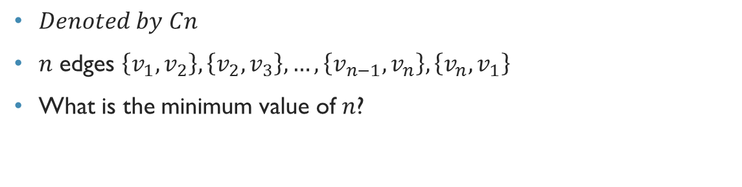
Cycles
$Denoted by Cn$
$n$ edges $\left\{v_{1},v_{2}\right\},\left\{v_{2},v_{3}\right\},…,\left\{v_{n−1},v_{n}\right\},\left\{v_{n},v_{1}\right\}$
What is the minimum value of $n$?

Slide 20
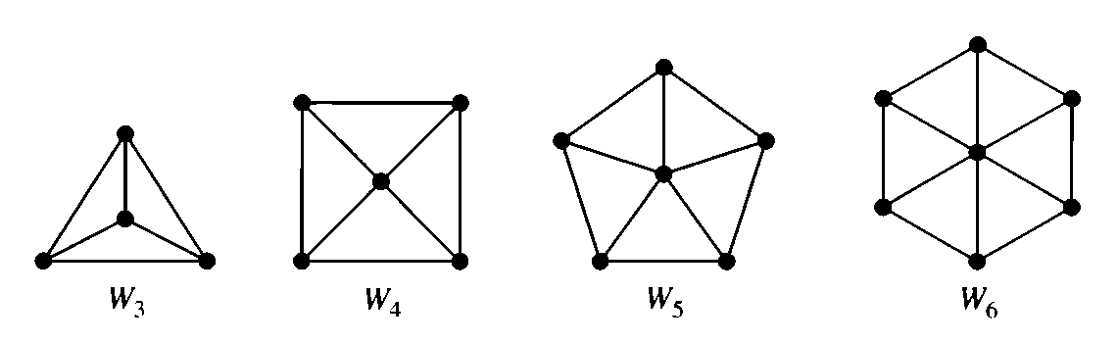
Wheels
An additional vertex to cycle, and connect every vertex of the cycle to the new one by an edge
What is the number of vertices in $W_{n}$?

Slide 21
Practice problem
Chapter-9.2(Rosen,6th edition)
Exercise- 3,4,5,10,20(a,d,e)

Slide 22
Bipartite graph
A simple graph G is called bipartite if its vertex set V can be partitioned into two disjoint sets V₁ and V₂ such that every edge in the graph connects a vertex in V₁ and a vertex in V₂ (so that no edge in G connects either two vertices in V₁ or two vertices in V₂). When this condition holds, we call the pair (V₁ , V₂) a bipartition of the vertex set V of G.

Slide 23
Bipartite graph
A
E
B
F
C
G
D
H

Slide 24
Bipartite graph
Jon
Annie
Ricky
Amy
Adam
Rachel
Nick
Linda
An edge represents that the two persons are married

Slide 25
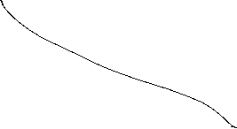
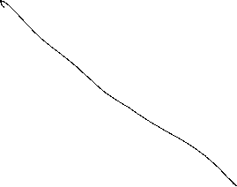
Bipartite graph
Jon
Annie
Ricky
Amy
Adam
Rachel
Nick
Linda
Left hand side represents actors and the right hand side represents directors
Assume that none of the actors have worked together in a movie
And none of the directors have collaborated and directed a movie

Slide 26
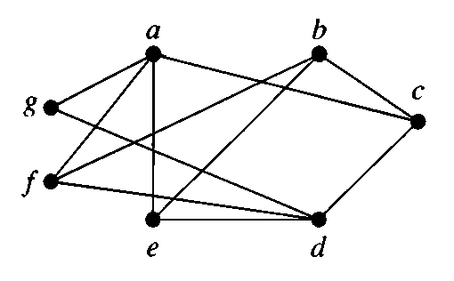
Is this graph bipartite?

Slide 27
Is this graph bipartite?
A
C
B
E
D
F
G

Slide 28
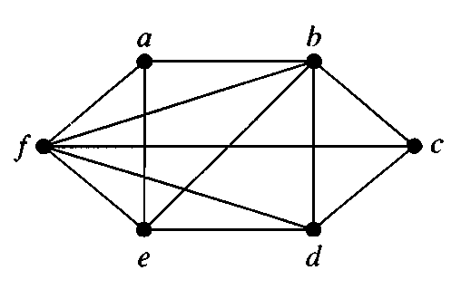
Is this graph bipartite?

Slide 29
Practice problem
Exercise- 21-25 (Chapter-9.2)

Slide 30
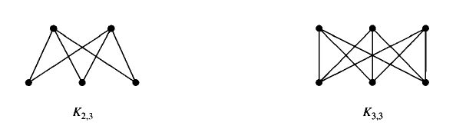
Complete Bipartite Graph

